Slide 1
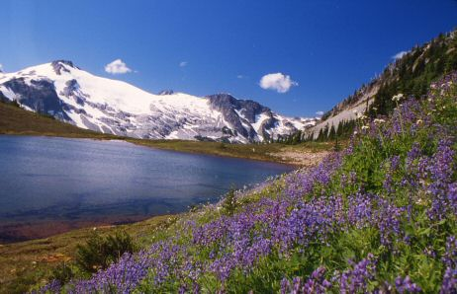
Ecosystems and Population Change

Slide 2
Interactions Within Ecosystems
Ecology – is the study of interactions between organisms and their living and non-living environments.

Slide 3
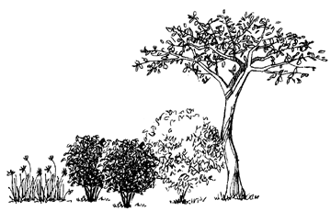
Ecotones – transition areas between ecosystems, usually characterized by greater biodiversity than either of the overlapping ecosystems. This increase in biodiversity creates more stable food webs for many organisms.

Slide 4
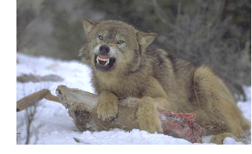
Ecological Niche – an organisms role in an ecosystem which includes its place in the food web, habitat, breeding area, etc.
Within ecosystems, each organism has its own specific role or place. No two species fulfill exactly the same role or ecological niche.

Slide 5
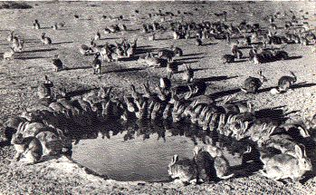
If a new species (exotic species) is introduced into an ecosystem, competition will result with any species that fulfills the same niche. Eventually, one of the two species will be out -competed and cannot survive in the ecosystem. During this process, the entire ecosystem will be disrupted.

Slide 6
Example: European rabbits were introduced to Australia to provide sport for game hunters. The rabbits had no natural predators, and became pests. The rabbit infestation resulted in the destruction of plant matter, crops and land. Agricultural grazing land became littered with rabbit holes that proved to be a hazard to grazing animals. Rabbits also dug under fences, allowing dingo’s (a native Australian wild dog) to sneak into paddocks and kill large numbers of sheep.

Slide 7
Some organisms like rabbits and mice have the ability to reproduce very rapidly, creating huge population explosions. Other organisms don’t have this capacity, and their populations will remain stable. A number of factors contribute to this phenomenon that we call Biotic Potential.

Slide 8
Biotic Potential – the maximum number of offspring a species could produce, when resources are unlimited. Biotic potential is determined by four factors:
1. Number of Offspring per Birth – maximum number of offspring in one reproductive cycle.
2. Breeding Frequency – number of times a species reproduces (reproductive cycles) per year.
3. Length of Reproductive Life - the age of sexual maturity to the age when reproductive ability is lost.
4. Capacity For Survival – the number of offspring that survive to reproductive age.

Slide 9
Let’s compare the biotic potential of a rabbit and a horse:
Factor Rabbit Horse
1. High: 4-10+ Low: 1
High: 30 days Low: 11 months
Short Long
Poor Good
Biotic High Low
Potential

Slide 10
Limiting Factors
Environmental conditions that may prevent populations from reaching their biotic potential.
Limiting factors may be biotic or abiotic

Slide 11
ABIOTIC FACTORS
too much / little light
temperature too cold / warm
harmful chemicals in the environment
BIOTIC FACTORS
insufficient food
excessive predators
diseases or parasites
diminished ability to compete

Slide 12
Carrying Capacity
is the maximum number of individuals of a particular species that can be supported in an ecosystem at a particular time. This is determined by the availability of food, presence of predators, disease and other resources. If a population exceeds the carrying capacity, there will be a decline in number until the population re-stabilizes.

Slide 13
Population Growth Curves
J Shaped Curve – Boom and Bust
Number of Indiv.
time

Slide 14
S Shaped Curve – Open Population, Stationary Curve
Number of Indiv.
Time

Slide 15
Lag Phase – birth rate is slow due to adjustment period
Growth Phase – exponential growth, high birth rate
Stationary Phase – birth rate = death rate
Death Phase – death rate is very high

Slide 16
Abiotic factors will often determine the number of organisms that can live in an ecosystem. Two basic rules govern the effects of abiotic factors:
Law of Minimums – states that the nutrient or resource in the least supply is the one that limits growth.
Ex. minimal water is required for plants for plants during a drought
Law of Tolerance – states that organisms can only tolerate or survive within a particular range of an abiotic factor.
Ex. tiger barb fish only live between 20 – 25oC.

Slide 17
Biotic factors can also determine the carrying capacity for a species in an ecosystem. These factors include:
Density dependent factors – affect populations because of the density (numbers) of individuals.
Ex. disease, food supply, predators, availability of sunlight / water due to competition, space
Density independent factors – affect members of a population regardless of the number of individuals present.
Ex. fire, flood, drought, chemicals, climate change and other natural disasters

Slide 18
Sustaining Ecosystems
Ecosystems are destined to change, gradually, over time. Sadly, human induced changes often leave ecosystems unable to replenish resources and the delicate balance of life is upset. Terrestrial and aquatic ecosystems each have a unique set of limiting factors and challenges that threaten their sustainability.

Slide 19
Terrestrial Ecosystems
Terrestrial ecosystems are limited by four major abiotic factors:
1. Soil: Provides nutrients for all plants that grow on land. Poor quality soil is an important limiting factor in many ecosystems

Slide 20
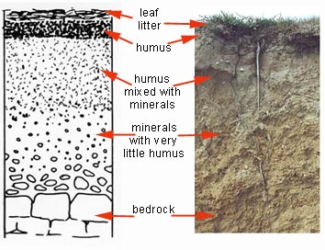
Litter – partly decomposed leaves and grasses
Topsoil – small particles of rock and decaying plant / animal matter
Subsoil – more rock with slight amounts of organic matter
Soil pH – acidity of the soil will be affected by acid deposition, leaching and by percolation. Different plants grow better under specific pH conditions.

Slide 21
2. Available Water: Precipitation that collects above ground is called surface water. Ground water is found in the spaces between soil and porous rock. The layer that is saturated with water is found within the water table. Usually, when there is more precipitation, there will be more ground water and the water table will rise. In little rainfall, the water table is lower. Plants adapt to this by sending roots down into the soil to the groundwater layer or down to the water table to bring up water and minerals.

Slide 22
3. Temperature: Many plants and animals adapt to a specific range of seasonal temperatures. A variety of strategies such as hibernation, shedding leaves, a winter coat and dormancy are used to help these organisms survive.

Slide 23
4. Sunlight: has an effect on all terrestrial ecosystems. The amount of sunlight usually varies with the geographical location and with the canopy plants that are growing in a specific area.

Slide 24
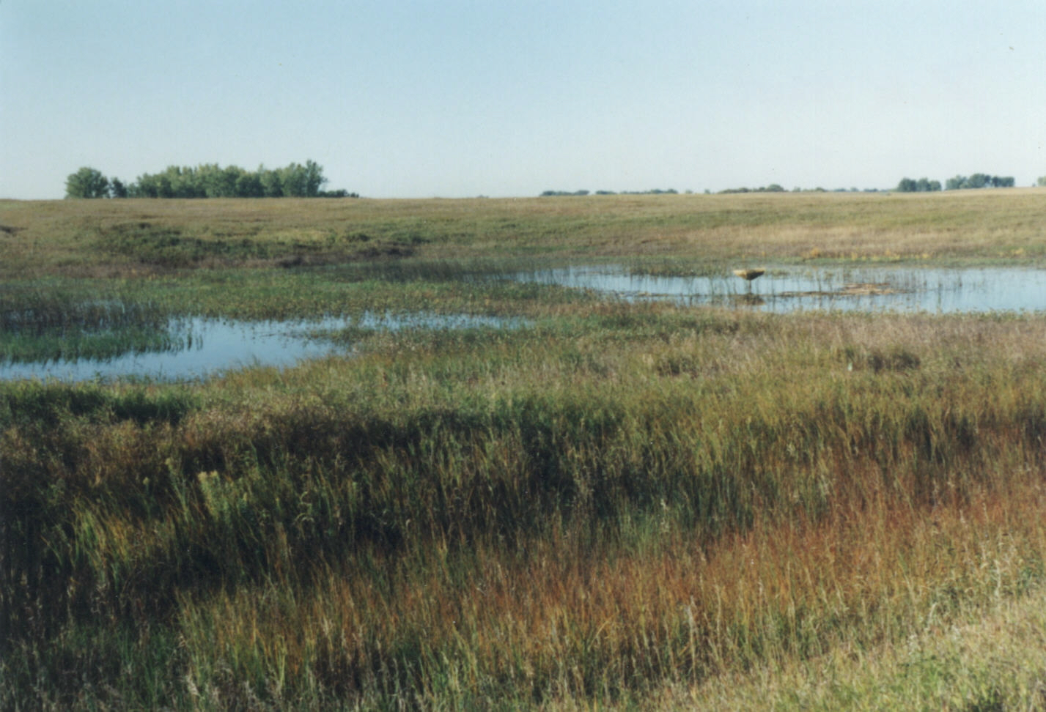
Grassland Biome

Slide 25
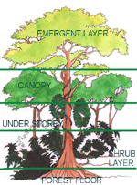
Deciduous Forest Biome

Slide 26
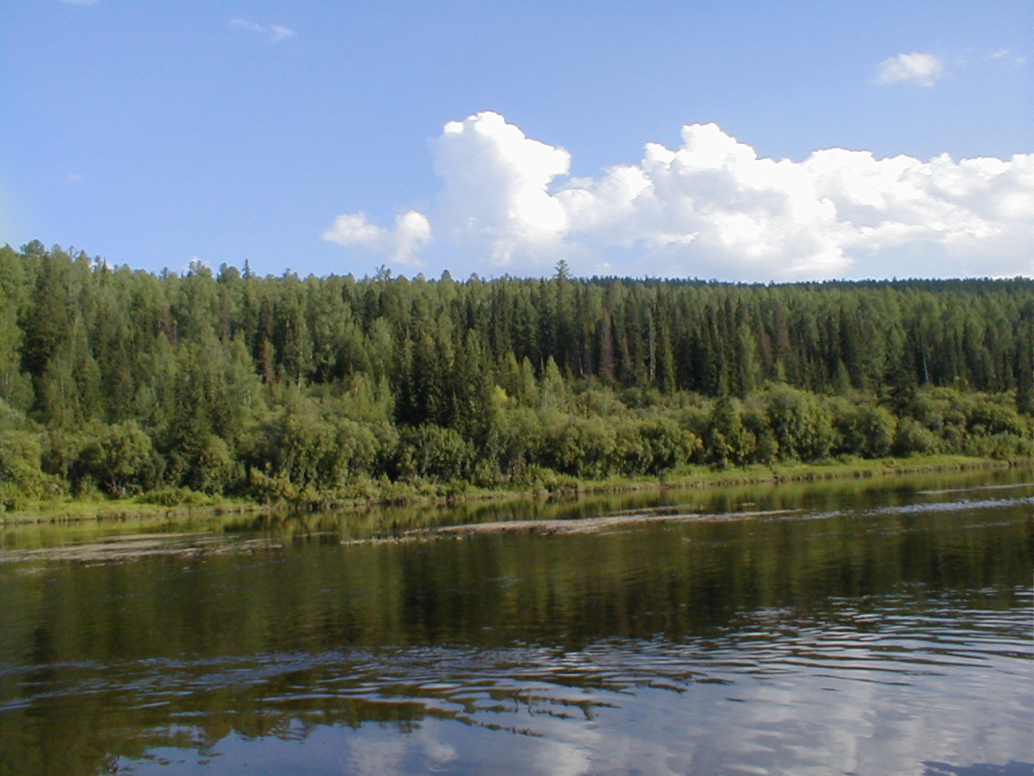
Taiga Biome

Slide 27
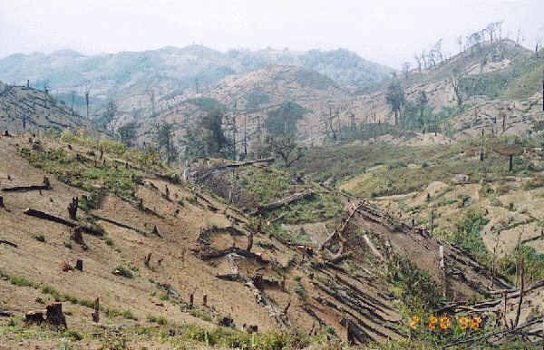
Changes to terrestrial ecosystems:
Forestry – deforestation by slash and burn, clear cutting or by selective cutting has an impact on ecosystems. The degree of impact depends upon the method used.

Slide 28
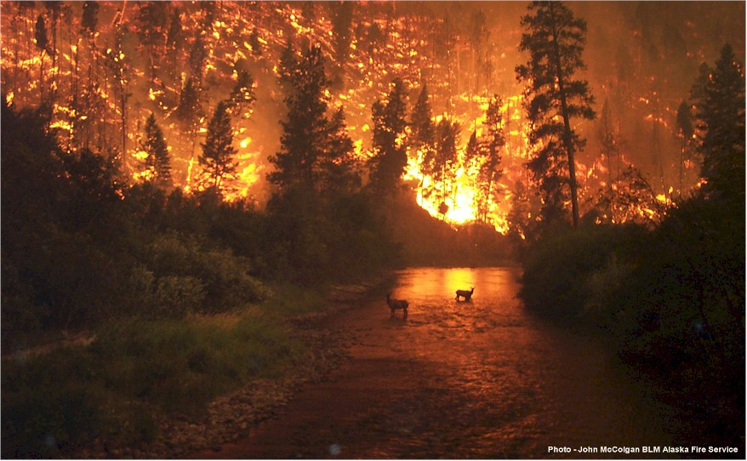
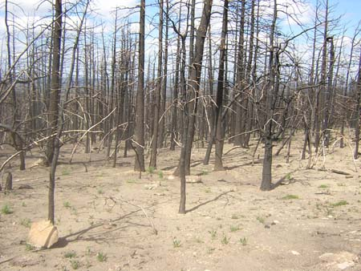
Forest Fires – are a natural ecological process and usually mean renewal and rebirth for most ecosystems. Fire is effective in cleaning up dead plant material and stimulating re-growth of young healthy plants. It is a quick way of recycling/decomposing waste and nutrients

Slide 29
Aquatic Ecosystems
Aquatic ecosystems are often very diverse and important to the earth’s ecological state. These ecosystems are affected by three major abiotic factors:
  chemical environment (***dissolved oxygen)
  light levels (***most important abiotic factor)
  temperature

Slide 30
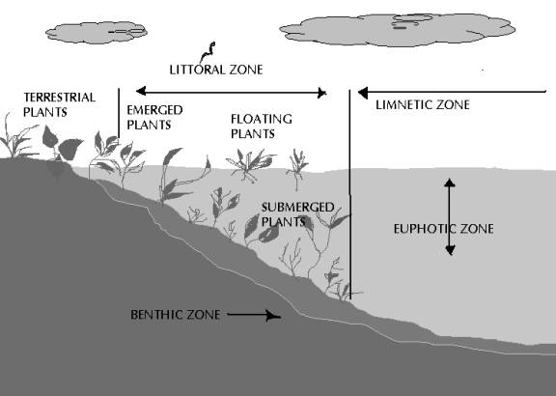
Lake Structures

Slide 31
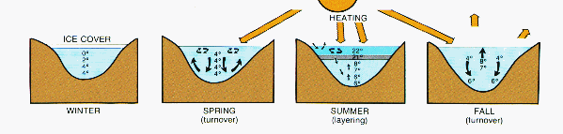
Seasonal Variation in Lakes
http://www.mhhe.com/biosci/genbio/tlw3/eBridge/Chp29/animations/ch29/lake_stratification.swf

Slide 32
There are two types of lakes
Oligotrophic lakes – are newer lakes that are deep, and cold with low nutrient levels. These lakes tend to support larger fish, as they have higher oxygen content.
Eutrophic lakes – are older lakes that have become filled in with detritus. The water is warm, shallow and nutrient rich. These lakes are on their way to becoming marshes and eventually dry land.

Slide 33
Water Quality
is determined by a number of specific indicators.
Bacteria – coliform bacteria occur naturally in human intestines and are found in human waste. Presence of bacteria indicates a higher risk of disease.
Dissolved Oxygen (DO) – as the dissolved oxygen in an aquatic ecosystem begins to drop, fewer organisms can be supported. DO is affected by the presence of decomposing bacteria and thermal pollution.
Biological Oxygen Demand (BOD) – is the amount of dissolved oxygen needed by decomposers to break down the organic matte in the water over 5 days.

